Slide 1

Specification Demo
EKE 749 Group Assignment 2
Team 6, Code Monkeys.

Slide 2


Code Monkeys
Notes:
Code Monkeys has two means.
First is an American animated television program created by Adam de la Peña. Set in the early 1980s, it follows the adventures of fictional video game company GameaVision.
Second, A Code monkey is a computer programmer or other person who writes computer code for a living. This term may be slightly derogatory, meaning that this developer can write some code but is unable to (or not supposed to) perform the more complex tasks of software architecture, analysis, and design^{[1]}. It is usually applied to junior programmers.

Slide 3
Contents
Objective
Features
Environment

Slide 4
Monkey Calendar
Objective
  Write a calendar and appointment cheduler system.
  Construct features, interface, limitation, etc..

Slide 5
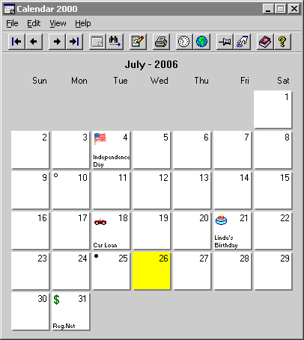
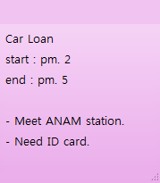
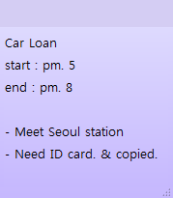
Monkey Calendar
Basic Requirements
Start : pm 2
End : pm 5
Notes:
1 Print the calendar for any year, month, week, or range of days
2 Add an appointment with a given date, start time, finish time, short subject, and long description.
3 Change the details of any appointment
4 Clear the set of appointments

Slide 6
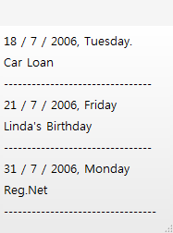

Monkey Calendar
Basic Requirements
Appointment1.MC
Notes:
5 Print all appointments for a given year, month, week, or day, printing either the short subject (for year or month) or long description (for week or day)
6 Save the set of all appointments to a file
7 Load one or more files, and modify, print, or save the loaded appointments from these files as described above

Slide 7
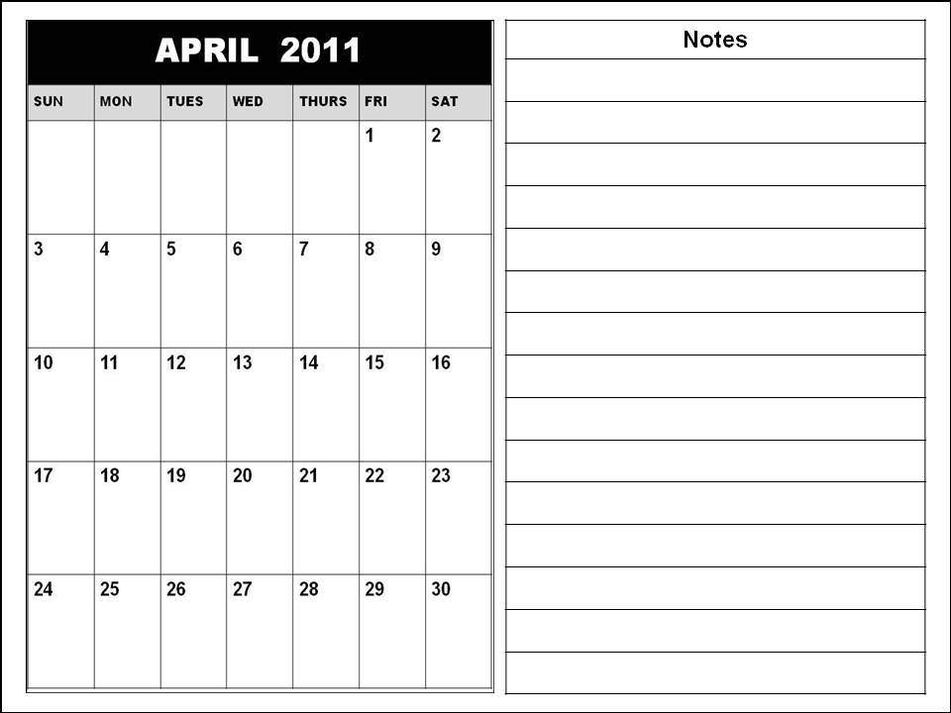
Monkey Calendar
Additional Features 1.
FEBRUARY
Name
Car Loan
Day
2 / 4 / 2011
Start
Pm. 5
End
Pm. 8
Location
Seoul station
People
Car manager
Need ID card & copied
Memo
Notes:
- Add additional fields, such as location, people attending, etc.
- Allow repeating Appointments (every Friday at 10:00, every January 1 at 0:00, every hour for 1 day)
- Add windowing (GUI) or browser interface, instead of just text : Android
- Allow appointment to span multiple days
- Report if two appointments are at the same time
- Add time zones, and additional languages (for example, both Korean and English) (optional)

Slide 8
Monkey Calendar
Additional Features 2.
FEBRUARY
MARCH
Volunteer Work
Name
Volunteer Work
Name
Day
3 / 9 / 2011
Day
2 / 9 / 2011
Start
Pm. 2
Start
Pm. 2
Pm. 7
End
Pm. 7
End
Location
Korea univ.
Location
Korea univ.
People
Colleague
People
Colleague
Sometimes location will be changed.
Sometimes location will be changed.
Memo
Memo
Notes:
- Add additional fields, such as location, people attending, etc.
- Allow repeating Appointments (every Friday at 10:00, every January 1 at 0:00, every hour for 1 day)
- Add windowing (GUI) or browser interface, instead of just text : Android
- Allow appointment to span multiple days
- Report if two appointments are at the same time
- Add time zones, and additional languages (for example, both Korean and English) (optional)

Slide 9

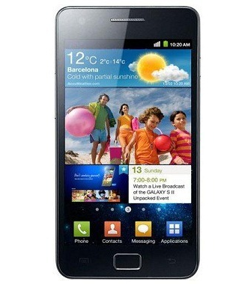
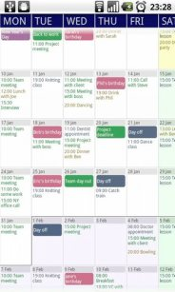
Monkey Calendar
Additional Features 3.
Notes:
- Add additional fields, such as location, people attending, etc.
- Allow repeating Appointments (every Friday at 10:00, every January 1 at 0:00, every hour for 1 day)
- Add windowing (GUI) or browser interface, instead of just text : Android
- Allow appointment to span multiple days
- Report if two appointments are at the same time
- Add time zones, and additional languages (for example, both Korean and English) (optional)

Slide 10
Monkey Calendar
Additional Features 6.
FEBRUARY
MARCH
Volunteer Work
Name
Volunteer Work
Name
Day
3 / 9 / 2011
Day
2 / 9 / 2011
Start
Pm. 2
Start
Pm. 2
Pm. 7
End
Pm. 7
End
Location
Korea univ.
Location
Korea univ.
People
Colleague
People
Colleague
Sometimes location will be changed.
Sometimes location will be changed.
Memo
Memo
Notes:
- Add additional fields, such as location, people attending, etc.
- Allow repeating Appointments (every Friday at 10:00, every January 1 at 0:00, every hour for 1 day)
- Add windowing (GUI) or browser interface, instead of just text : Android
- Allow appointment to span multiple days
- Report if two appointments are at the same time
- Add time zones, and additional languages (for example, both Korean and English) (optional)

Slide 11
Monkey Calendar
Additional Features 6.
FEBRUARY
내용
3월
Volunteer Work
제목
Volunteer Work
Name
일
월
화
수
목
금
토
날짜
3 / 9 / 2011
Day
2 / 9 / 2011
시작시간
Pm. 2
Start
Pm. 2
Pm. 7
끝시간
Pm. 7
End
장소
Korea univ.
Location
Korea univ.
사람
Colleague
People
Colleague
Sometimes location will be changed.
Sometimes location will be changed.
메모
Memo
Notes:
- Add additional fields, such as location, people attending, etc.
- Allow repeating Appointments (every Friday at 10:00, every January 1 at 0:00, every hour for 1 day)
- Add windowing (GUI) or browser interface, instead of just text : Android
- Allow appointment to span multiple days
- Report if two appointments are at the same time
- Add time zones, and additional languages (for example, both Korean and English) (optional)

Slide 12
Environment
Android 2.1(Éclair)
Display
  Bigger than 3.5”
  Resolution : Higher than 800 x 480
Interface
  Touch based interface
  Type by virtual keyboard

Slide 13
Fin.
Ask me anything!

